Slide 1

NAME- NIDHI
CLASS- 12TH
“COMMERCE”
Presentation On-
WORLD NO TOBACCO DAY

Slide 2


Slide 3
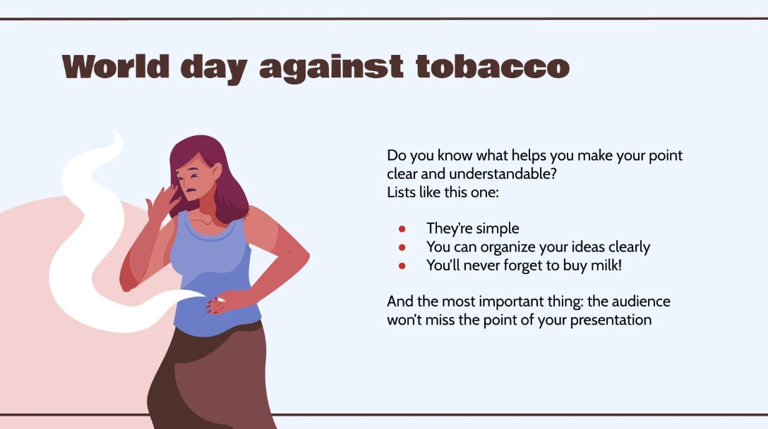

Slide 4
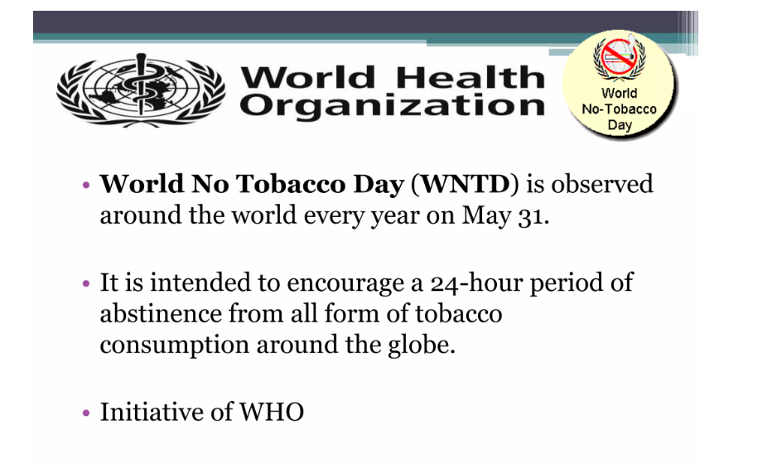

Slide 5
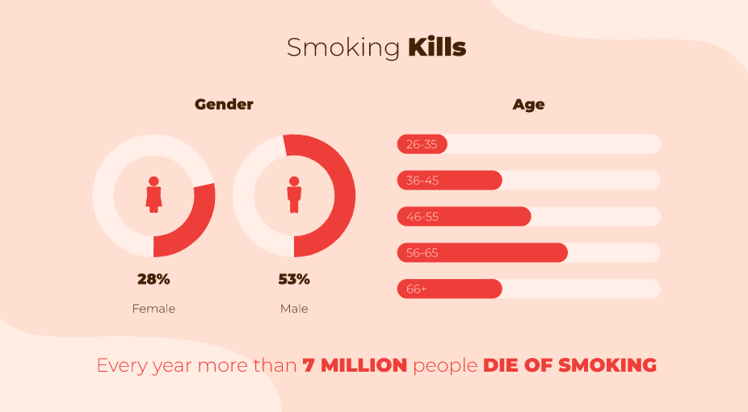

Slide 6


Slide 7
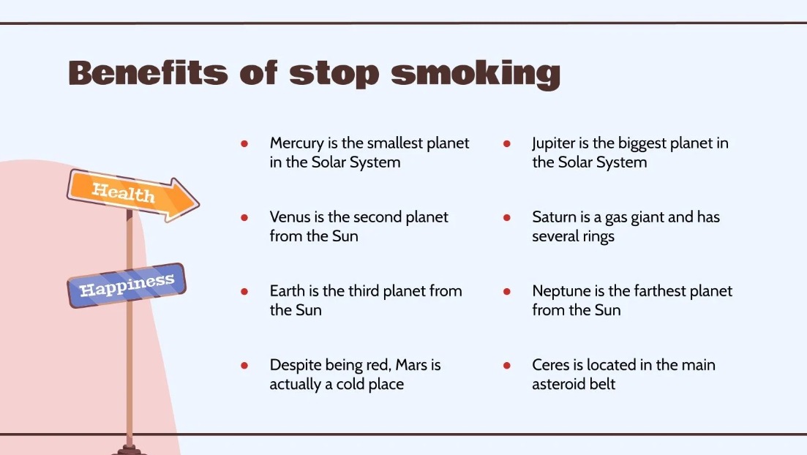

Slide 8
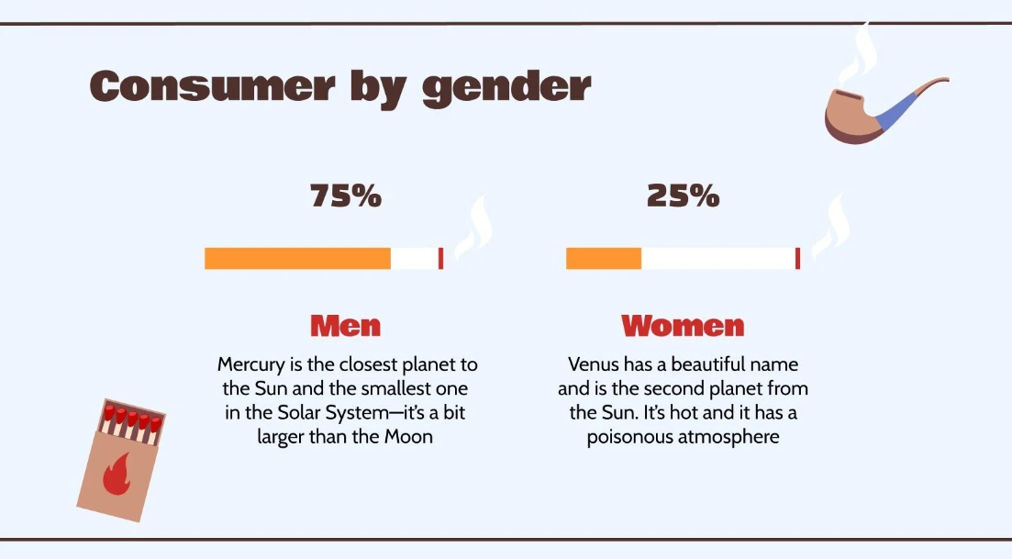

Slide 9


