Slide 1

WORLD NO TOBACCO DAY
By- SONALI
12TH SCIENCE

Slide 2

Introduction
In 1987, the World Health Organisation passed a resolution that announced April 7, 1988, as ‘World No Smoking Day’.
The act was passed to motivate people to prevent using tobacco for at least 24 hours.
Later in 1988, the organisation passed another resolution that World No Tobacco Day will be observed on May 31.

Slide 3
Why Do People Start Smoking ?
Most people who smoke started smoking when they were teenagers.
Those who have friends and/or parents who smoke are more likely to start smoking than those who don’t.
Some teenagers say that they “just wanted to try it” or they thought it was “cool” to smoke.
To avoid tension, anxiety, depressant.
Movies showing people smoking are another big influence.

Slide 4
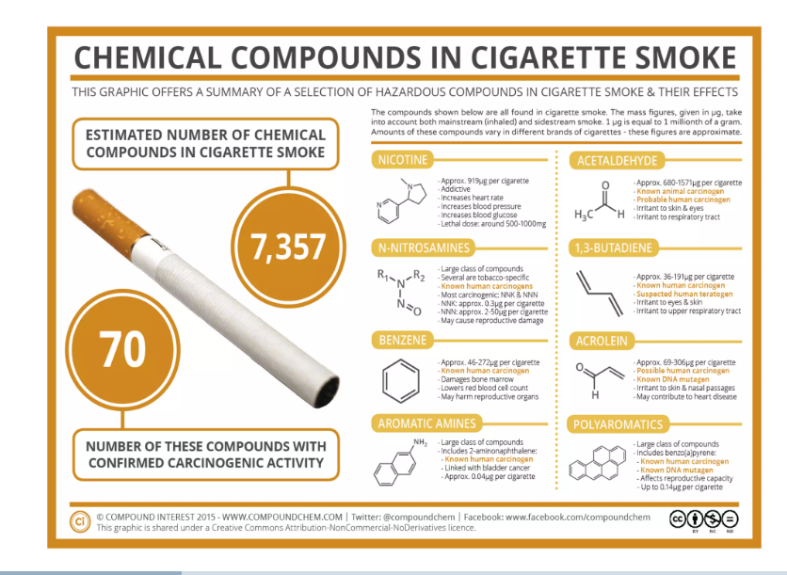

Slide 5
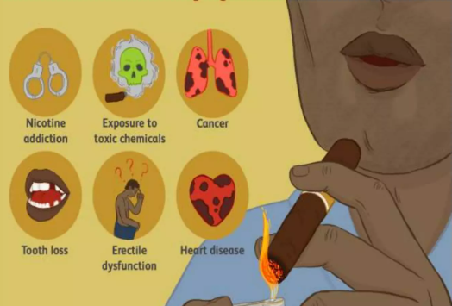
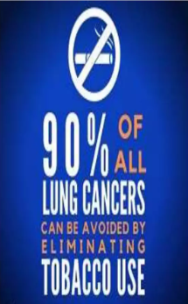
Causes

Slide 6
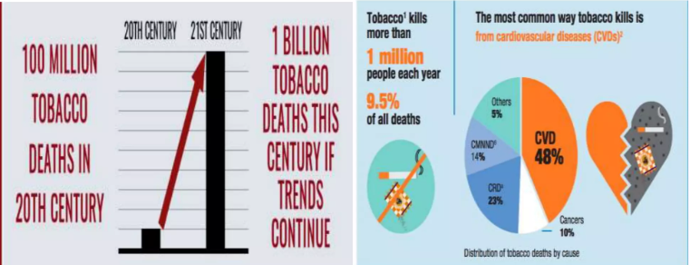
Statistics
Tobacco is one of the biggest public health threats the world has ever faced, killing move than 8 million people a year around the world
According to WHO, tobacco kill more than 1 million people each year in India, accounting for 9.5% of all Deaths

Slide 7
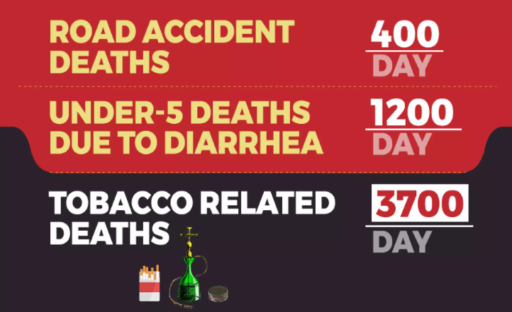
Facts

Slide 8
Benefits of not taking tobacco
Good health.
Prevent different type of disease.
Family life will be better.
Avoid dependency and live happy life.
Longer survival.
Lower risk for infection.
Easier breathing.
Better quality of life.

Slide 9
Pledge
On the occasion of world no tobacco day, I take a pledge that I shall never smoke, and consume any type of tobacco products in my life and motivate and acquaintance to not to smoke and use any tobacco products. I shall keep the campus of my school tobacco free and also motivate my colleagues for the same

Slide 10
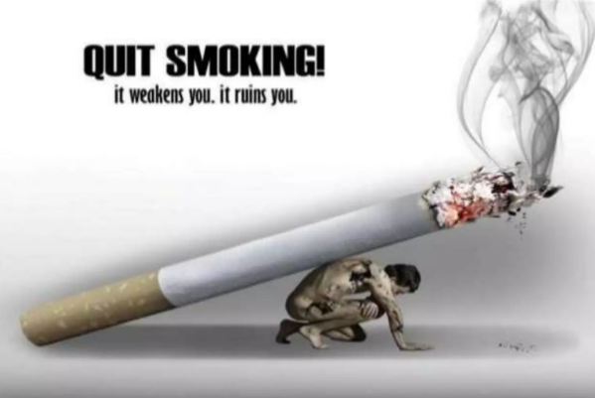
THANKS YOU!!
.

